Slide 1
Evolutionary Computing
Chapter 6

Slide 2
Chapter 6: Popular Evolutionary Algorithm Variants
Historical EA variants:
Genetic Algorithms
Evolution Strategies
Evolutionary Programming
Genetic Programming
More recent versions:
Differential Evolution
Particle Swarm Optimisation
Estimation of Distribution Algorithms
Learning Classifier Systems

Slide 3
Genetic Algorithms: Quick Overview (1/2)
Developed: USA in the 1960’s
Early names: J. Holland, K. DeJong, D. Goldberg
Typically applied to:
discrete function optimization
benchmark
straightforward problems binary representation
Features:
not too fast
missing new variants (elitsm, sus)
often modelled by theorists

Slide 4
Genetic Algorithms: Quick Overview (2/2)
Holland’s original GA is now known as the simple genetic algorithm (SGA)
Other GAs use different:
Representations
Mutations
Crossovers
Selection mechanisms

Slide 5
Genetic Algorithms: SGA technical summary tableau
Representation | Bit-strings
Recombination | 1-Point crossover
Mutation | Bit flip
Parent selection | Fitness proportional – implemented by Roulette Wheel
Survivor selection | Generational

Slide 6
Genetic Algorithms: SGA reproduction cycle
Select parents for the mating pool
(size of mating pool = population size)
Shuffle the mating pool
Apply crossover for each consecutive pair with probability p_{c}, otherwise copy parents
Apply mutation for each offspring (bit-flip with probability p_{m} independently for each bit)
Replace the whole population with the resulting offspring

Slide 7
Genetic Algorithms: An example after Goldberg ’89
Simple problem: max x² over {0,1,…,31}
GA approach:
Representation: binary code, e.g., 01101 ↔ 13
Population size: 4
1-point xover, bitwise mutation
Roulette wheel selection
Random initialisation
We show one generational cycle done by hand

Slide 8
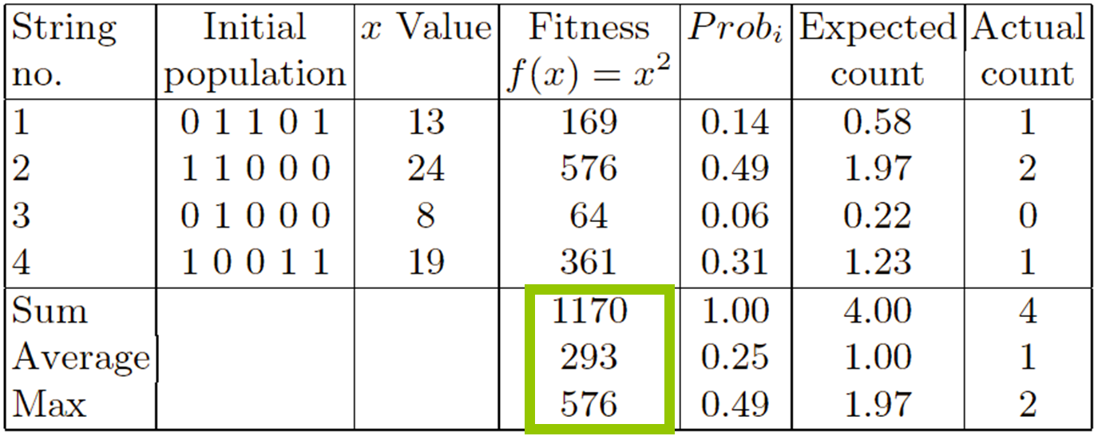
X² example: Selection

Slide 9
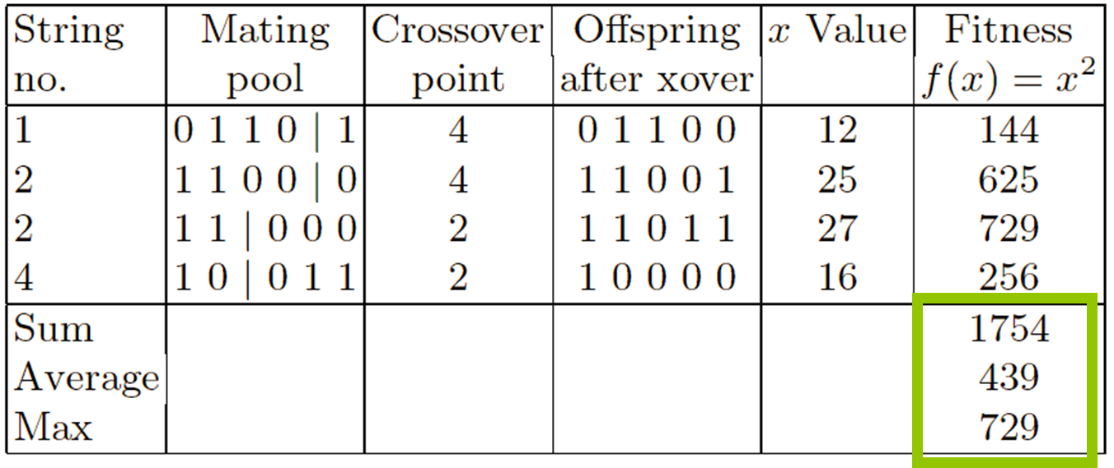
X² example: Crossover

Slide 10
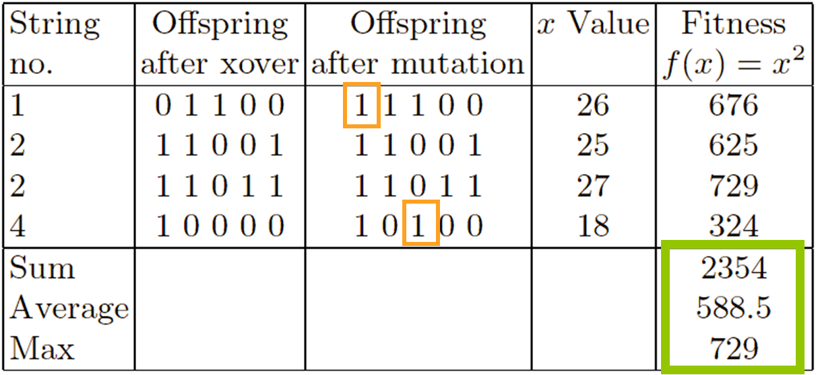
X² example: Mutation

Slide 11
Genetic Algorithms: The simple GA
Has been subject of many (early) studies
still often used as benchmark for novel GAs
Shows many shortcomings, e.g.,
Representation is too restrictive
Mutation & crossover operators only applicable for bit-string & integer representations
Selection mechanism sensitive for converging populations with close fitness values
Generational population model (step 5 in SGA repr. cycle) can be improved with explicit survivor selection

Slide 12
Evolution Strategies: Quick overview
Developed: Germany in the 1960’s
Early names: I. Rechenberg, H.-P. Schwefel
Typically applied to:
numerical optimisation
Attributed features:
fast
good optimizer for real-valued optimisation
relatively much theory
Special:
self-adaptation of (mutation) parameters standard

Slide 13
Evolution Strategies: ES technical summary tableau
Representation | Real-valued vectors
Recombination | Discrete or intermediary
Mutation | Gaussian perturbation
Parent selection | Uniform random
Survivor selection | (μ,λ) or (μ+λ)

Slide 14
Evolution Strategies: Example (1+1) ES
Task: minimimise f : R^{n} → R
Algorithm: “two-membered ES” using
Vectors from R^{n} directly as chromosomes
Population size 1
Only mutation creating one child
Greedy selection

Slide 15
Evolution Strategies: Introductory example: mutation mechanism
z values drawn from normal distribution N(ξ,σ)
mean ξ is set to 0
variation σ is called mutation step size
σ is varied on the fly by the “1/5 success rule”:
This rule resets σ after every k iterations by
σ = σ / c if p_{s} > 1/5
σ = σ • c if p_{s} < 1/5
σ = σ if p_{s} = 1/5
where p_{s} is the % of successful mutations, 0.8 ≤ c ≤ 1

Slide 16
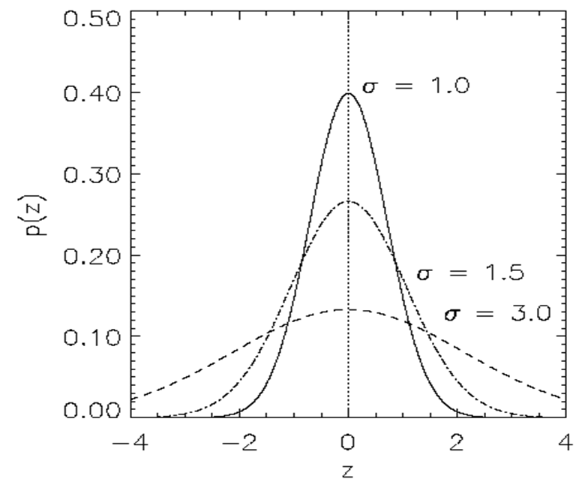
Evolution Strategies: Illustration of normal distribution

Slide 17
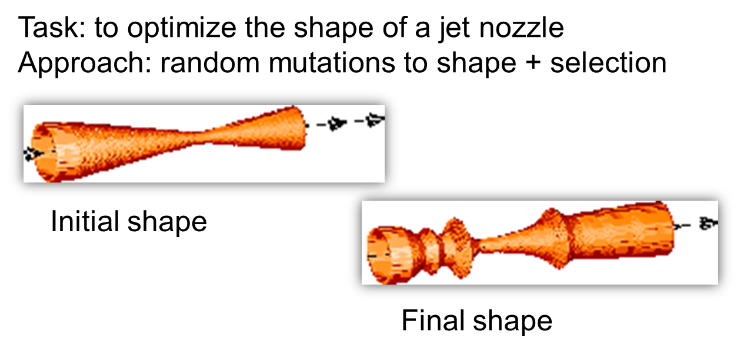
Another historical example: the jet nozzle experiment

Slide 18
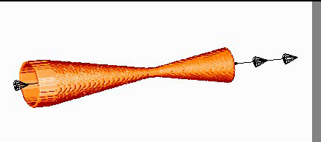
The famous jet nozzle experiment (movie)

Slide 19
Evolution Strategies: Representation
Chromosomes consist of three parts:
Object variables: x₁,…,x_{n}
Strategy parameters:
Mutation step sizes: σ₁,…,σ_{nσ}
Rotation angles: α₁,…, α_{nα}
Not every component is always present
Full size: ⟨ x₁,…,x_{n}, σ₁,…,σ_{n} ,α₁,…, α_{k} ⟩
where k = n(n-1)/2 (no. of i,j pairs)

Slide 20
Evolution Strategies: Recombination
Creates one child
Acts per variable / position by either
Averaging parental values, or
Selecting one of the parental values
From two or more parents by either:
Using two selected parents to make a child
Selecting two parents for each position

Slide 21
Evolution Strategies: Names of recombinations
 | Two fixed parents | Two parents selected for each i
z_{i} = (x_{i} + y_{i})/2 | Local intermediary | Global intermediary
z_{i} is x_{i} or y_{i} chosen randomly | Local discrete | Global discrete

Slide 22
Evolution Strategies: Parent selection
Parents are selected by uniform random distribution whenever an operator needs one/some
Thus: ES parent selection is unbiased - every individual has the same probability to be selected

Slide 23
Evolution Strategies: Self-adaptation illustrated (1/2)
Given a dynamically changing fitness landscape (optimum location shifted every 200 generations)
Self-adaptive ES is able to
follow the optimum and
adjust the mutation step size after every shift !

Slide 24
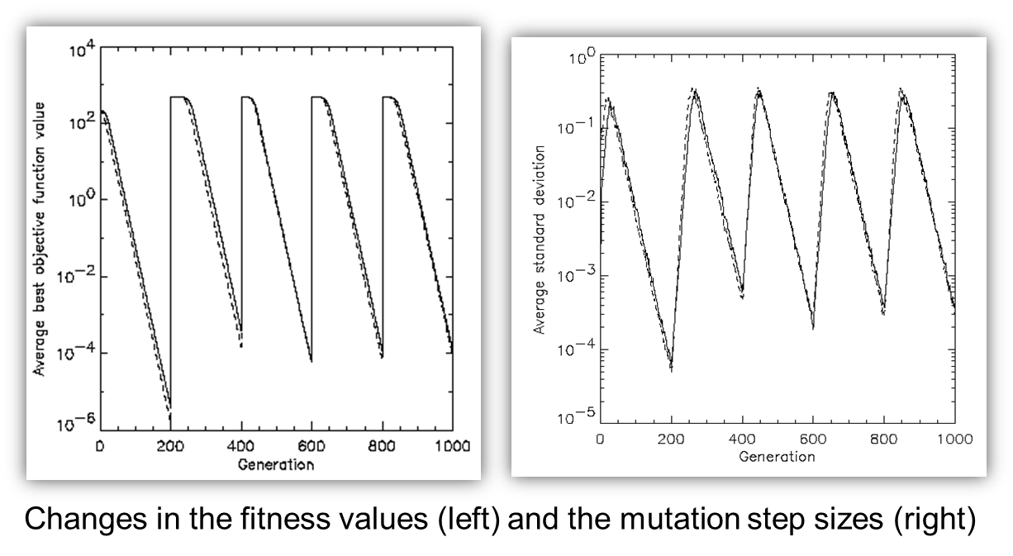
Evolution Strategies: Self-adaptation illustrated cont’d (2/2)

Slide 25
Evolution Strategies: Prerequisites for self-adaptation
μ > 1 to carry different strategies
λ > μ to generate offspring surplus
(μ,λ)-selection to get rid of misadapted σ‘s
Mixing strategy parameters by (intermediary) recombination on them

Slide 26
Evolution Strategies: Selection Pressure
Takeover time τ* is a measure to quantify the selection pressure
The number of generations it takes until the application of selection completely fills the population with copies of the best individual
Goldberg and Deb showed:
For proportional selection in a genetic algorithm the takeover time is λln(λ)

Slide 27
Example application: The cherry brandy experiment (1/2)
Task: to create a colour mix yielding a target colour (that of a well known cherry brandy)
Ingredients: water + red, yellow, blue dye
Representation: ⟨ w, r, y ,b ⟩ no self-adaptation!
Values scaled to give a predefined total volume (30 ml)
Mutation: lo / med / hi σ values used with equal chance
Selection: (1,8) strategy

Slide 28
Example application: The cherry brandy experiment (2/2)
Fitness: students effectively making the mix and comparing it with target colour
Termination criterion: student satisfied with mixed colour
Solution is found mostly within 20 generations
Accuracy is very good

Slide 29
Example application: The Ackley function (Bäck et al ’93)
The Ackley function (here used with n =30):
Evolution strategy:
Representation:
-30 < x_{i} < 30
30 step sizes
(30,200) selection
Termination : after 200000 fitness evaluations
Results: average best solution is 7.48 • 10 ^{–8} (very good)

Slide 30
Evolutionary Programming: Quick overview
Developed: USA in the 1960’s
Early names: D. Fogel
Typically applied to:
traditional EP: prediction by finite state machines
contemporary EP: (numerical) optimization
Attributed features:
very open framework: any representation and mutation op’s OK
crossbred with ES (contemporary EP)
consequently: hard to say what “standard” EP is
Special:
no recombination
self-adaptation of parameters standard (contemporary EP)

Slide 31
Evolutionary Programming: Technical summary tableau
Representation | Real-valued vectors
Recombination | None
Mutation | Gaussian perturbation
Parent selection | Deterministic (each parent one offspring)
Survivor selection | Probabilistic (μ+μ)

Slide 32
Evolutionary Programming: Historical EP perspective
EP aimed at achieving intelligence
Intelligence was viewed as adaptive behaviour
Prediction of the environment was considered a prerequisite to adaptive behaviour
Thus: capability to predict is key to intelligence

Slide 33
Evolutionary Programming: Prediction by finite state machines
Finite state machine (FSM):
States S
Inputs I
Outputs O
Transition function δ : S x I → S x O
Transforms input stream into output stream
Can be used for predictions, e.g. to predict next input symbol in a sequence

Slide 34
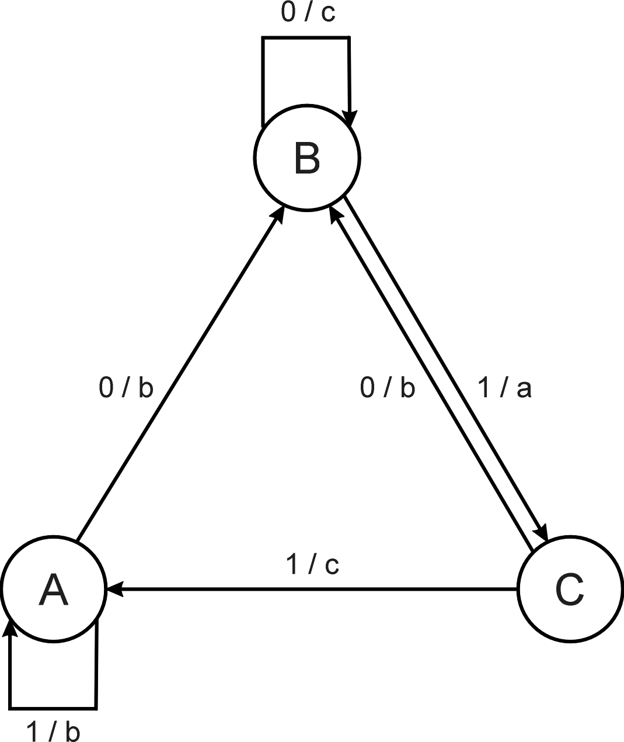
Evolutionary Programming: FSM example
Consider the FSM with:
S = {A, B, C}
I = {0, 1}
O = {a, b, c}
δ given by a diagram

Slide 35
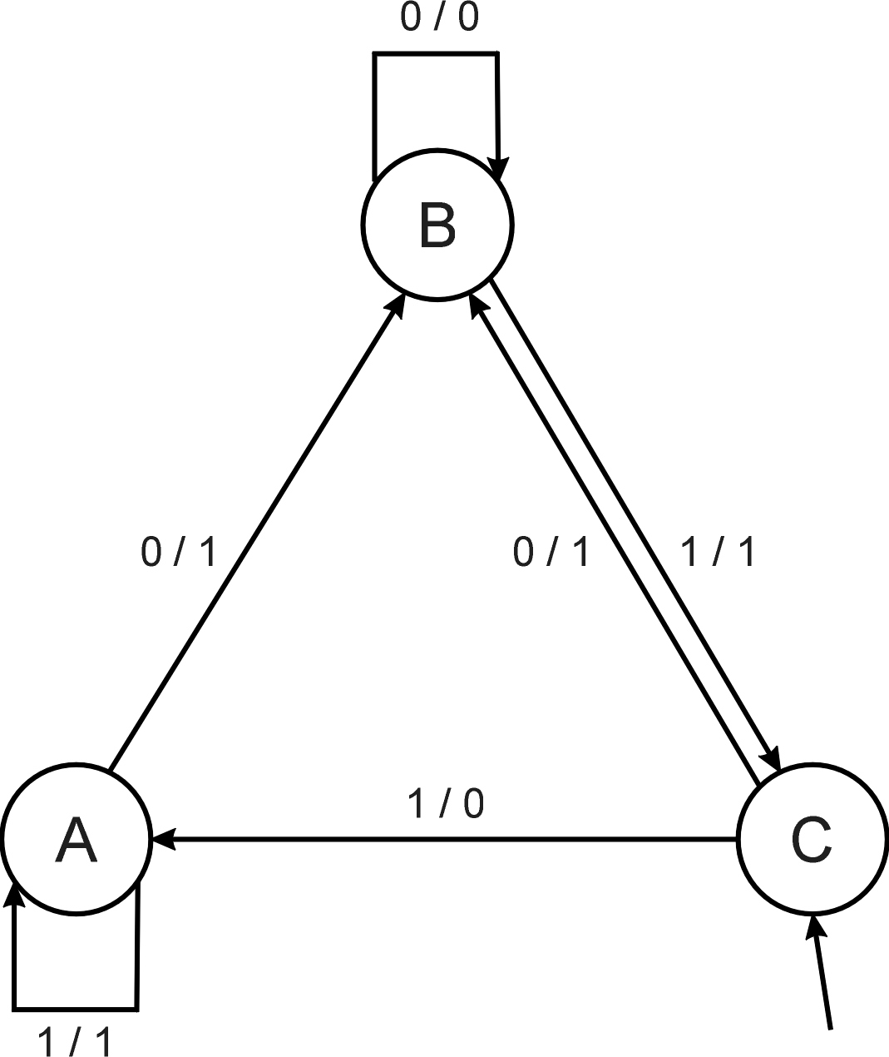
Evolutionary Programming: FSM as predictor
Consider the following FSM
Task: predict next input
Quality: % of in_{(i+1)} = out_{i}
Given initial state C
Input sequence 011101
Leads to output 110111
Quality: 3 out of 5

Slide 36
Evolutionary Programming: Evolving FSMs to predict primes (1/2)
P(n) = 1 if n is prime, 0 otherwise
I = N = {1,2,3,…, n, …}
O = {0,1}
Correct prediction: out_{i}= P(in(i+1))
Fitness function:
1 point for correct prediction of next input
0 point for incorrect prediction
Penalty for “too many” states

Slide 37
Evolutionary Programming: Evolving FSMs to predict primes (1/2)
Parent selection: each FSM is mutated once
Mutation operators (one selected randomly):
Change an output symbol
Change a state transition (i.e. redirect edge)
Add a state
Delete a state
Change the initial state
Survivor selection: (μ+μ)
Results: overfitting, after 202 inputs best FSM had one state and both outputs were 0, i.e., it always predicted “not prime”
Main point: not perfect accuracy but proof that simulated evolutionary process can create good solutions for intelligent task

Slide 38
Evolutionary Programming: Modern EP
No predefined representation in general
Thus: no predefined mutation (must match representation)
Often applies self-adaptation of mutation parameters

Slide 39
Evolutionary Programming: Representation
For continuous parameter optimisation
Chromosomes consist of two parts:
Object variables: x₁,…,x_{n}
Mutation step sizes: σ₁,…,σ_{n}
Full size: ⟨ x₁,…,x_{n}, σ₁,…,σ_{n} ⟩

Slide 40
Evolutionary Programming: Mutation
Chromosomes: ⟨ x₁,…,x_{n}, σ₁,…,σ_{n} ⟩
σ_{i}’ = σ_{i} • (1 + α • N(0,1))
x_{i}’ = x_{i} + σ_{i}’ • N_{i}(0,1)
α ≈ 0.2
boundary rule: σ’ < ε₀ ⇒ σ’ = ε₀
Other variants proposed & tried:
Using variance instead of standard deviation
Mutate σ-last
Other distributions, e.g, Cauchy instead of Gaussian

Slide 41
Evolutionary Programming: Recombination
None
Rationale: one point in the search space stands for a species, not for an individual and there can be no crossover between species
Much historical debate “mutation vs. crossover”

Slide 42
Evolutionary Programming: Parent selection
Each individual creates one child by mutation
Thus:
Deterministic
Not biased by fitness

Slide 43
Evolutionary Programming: Evolving checkers players (Fogel’02) (1/2)
Neural nets for evaluating future values of moves are evolved
NNs have fixed structure with 5046 weights, these are evolved + one weight for “kings”
Representation:
vector of 5046 real numbers for object variables (weights)
vector of 5046 real numbers for σ‘s
Mutation:
Gaussian, lognormal scheme with σ-first
Plus special mechanism for the kings’ weight
Population size 15

Slide 44
Evolutionary Programming: Evolving checkers players (Fogel’02) (2/2)
Tournament size q = 5
Programs (with NN inside) play against other programs, no human trainer or hard-wired intelligence
After 840 generation (6 months!) best strategy was tested against humans via Internet
Program earned “expert class” ranking outperforming 99.61% of all rated players

Slide 45
Genetic Programming: Quick overview
Developed: USA in the 1990’s
Early names: J. Koza
Typically applied to:
machine learning tasks (prediction, classification…)
Attributed features:
competes with neural nets and alike
needs huge populations (thousands)
slow
Special:
non-linear chromosomes: trees, graphs
mutation possible but not necessary

Slide 46
Genetic Programming: Technical summary tableau
Representation | Tree structures
Recombination | Exchange of subtrees
Mutation | Random change in trees
Parent selection | Fitness proportional
Survivor selection | Generational replacement

Slide 47
Genetic Programming: Example credit scoring (1/3)
Bank wants to distinguish good from bad loan applicants
Model needed that matches historical data
ID | No of children | Salary | Marital status | OK?
ID-1 | 2 | 45000 | Married | 0
ID-2 | 0 | 30000 | Single | 1
ID-3 | 1 | 40000 | Divorced | 1
…

Slide 48
Genetic Programming: Example credit scoring (2/3)
A possible model:
IF (NOC = 2) AND (S > 80000) THEN good ELSE bad
In general:
IF formula THEN good ELSE bad
Only unknown is the right formula, hence
Our search space (phenotypes) is the set of formulas
Natural fitness of a formula: percentage of well classified cases of the model it stands for

Slide 49
Genetic Programming: Example credit scoring (3/3)
IF (NOC = 2) AND (S > 80000) THEN good ELSE bad
can be represented by the following tree
AND
=
>
NOC
2
S
80000

Slide 50
Genetic Programming: Offspring creation scheme
Compare
GA scheme using crossover AND mutation sequentially (be it probabilistically)
GP scheme using crossover OR mutation (chosen probabilistically)

Slide 51
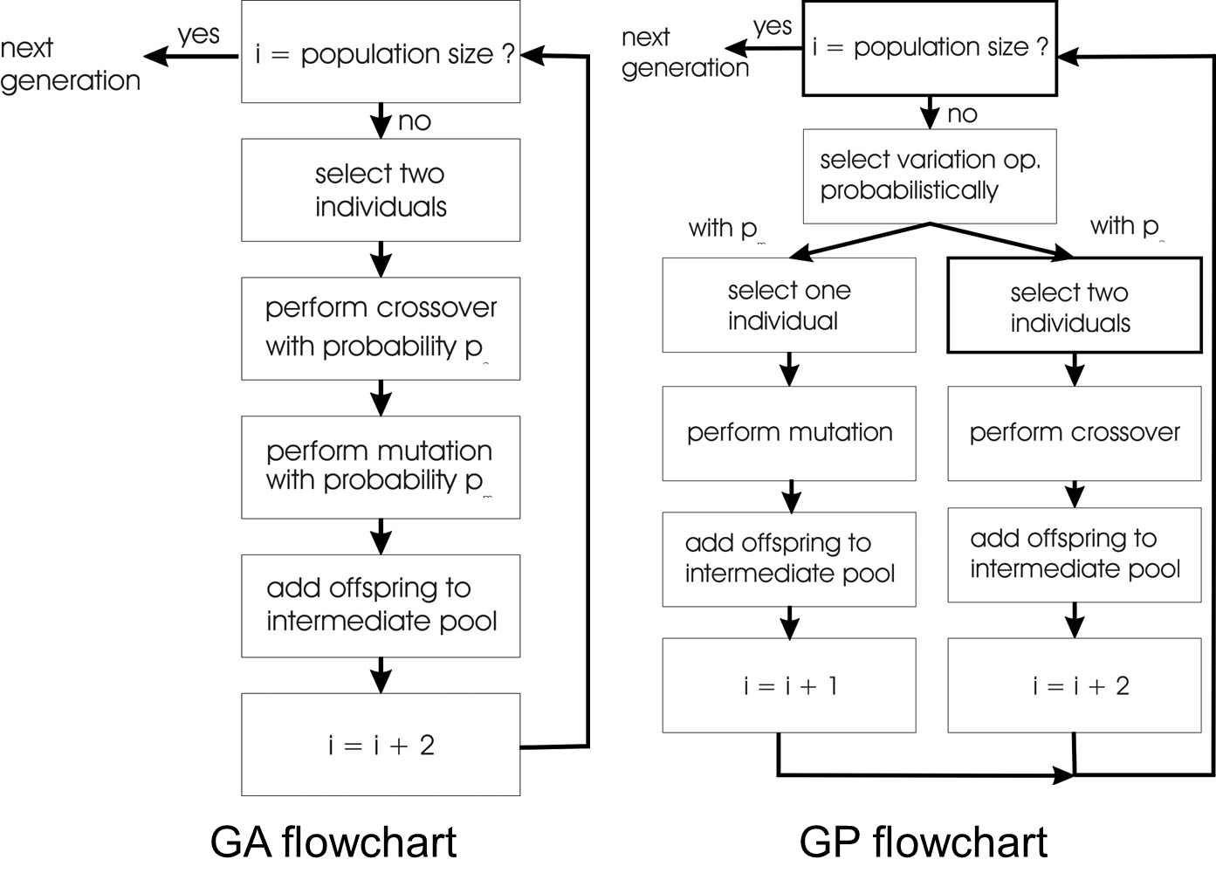
Genetic Programming: GA vs GP

Slide 52
Genetic Programming: Selection
Parent selection typically fitness proportionate
Over-selection in very large populations
rank population by fitness and divide it into two groups:
group 1: best x% of population, group 2 other (100-x)%
80% of selection operations chooses from group 1, 20% from group 2
for pop. size = 1000, 2000, 4000, 8000 x = 32%, 16%, 8%, 4%
motivation: to increase efficiency, %’s come from rule of thumb
Survivor selection:
Typical: generational scheme (thus none)
Recently steady-state is becoming popular for its elitism

Slide 53
Genetic Programming: Initialisation
Maximum initial depth of trees D_{max} is set
Full method (each branch has depth = D_{max}):
nodes at depth d < D_{max} randomly chosen from function set F
nodes at depth d = D_{max} randomly chosen from terminal set T
Grow method (each branch has depth ≤ D_{max}):
nodes at depth d < D_{max} randomly chosen from F ∪ T
nodes at depth d = D_{max} randomly chosen from T
Common GP initialisation: ramped half-and-half, where grow & full method each deliver half of initial population

Slide 54
Genetic Programming: Bloat
Bloat = “survival of the fattest”, i.e., the tree sizes in the population are increasing over time
Ongoing research and debate about the reasons
Needs countermeasures, e.g.
Prohibiting variation operators that would deliver “too big” children
Parsimony pressure: penalty for being oversized

Slide 55
Genetic Programming: Example symbolic regression
Given some points in R², (x₁, y₁), … , (x_{n}, y_{n})
Find function f(x) s.t. ∀i = 1, …, n : f(x_{i}) = y_{i}
Possible GP solution:
Representation by F = {+, -, /, sin, cos}, T = R ∪ {x}
Fitness is the error
All operators standard
pop.size = 1000, ramped half-half initialisation
Termination: n “hits” or 50000 fitness evaluations reached (where “hit” is if | f(x_{i}) – y_{i} | < 0.0001)

Slide 56
Differential Evolution: Quick overview
Developed: USA in 1995
Early names: Storn, Price
Typically applied to:
Nonlinear and non differentiable continuous space functions
Attributed features:
populations are lists
four parents are needed to create a new individual
different variants exists due to changing the base vector
Special:
differential mutation

Slide 57
Differential Evolution: Technical summary tableau
Representation | Real-valued vectors
Recombination | Uniform crossover
Mutation | Differential mutation
Parent selection | Uniform random selection of the 3 necessary vectors
Survivor selection | Deterministic elitist replacement (parent vs child)

Slide 58
Differential Evolution: Differential mutation
Given a population of candidate solution vectors in IR^{n}
A new mutant is produced by adding a perturbation vector: where y and x are randomly chosen population members and scaling factor F>0 is a real number controlling the rate at which the population evolves

Slide 59
Differential Evolution: Uniform crossover
DE uses uniform crossover but with a slight twist
At one randomly chosen position the child allele is taken from the first parent without making a random decision (duplication second parent not possible)
The number of inherited mutant alleles follows a binomial distribution

Slide 60
Differential Evolution: Evolutionary cycle
Population is a list, not related to fitness value
Creating a mutant vector population
For each new mutant, three vectors are chosen randomly from the population P (base vector υ and two others, y and z)
Trial vector population is created
Uniform crossover between and
Deterministic selection applied to each pair and
where the i-th individual in next generation is the one with highest fitness value

Slide 61
Differential Evolution: Different variants
Different variants exists due to changing the base vector
The variant is described as DE/a/b/c where
a is the base vector (rand or best)
b is the number of different vectors to define perturbation vector example four randomly chosen:
c denotes the crossover scheme (“bin” is uniform crossover)

Slide 62
Differential Evolution: evolving picture Darth Vader
Individual represented as 18000 values in range [0,1]
Pop size = 400, F = 0.1, Crossover rate = 0.1
Fitness = squared difference value individual with target value
MOVIE TOO BIG – PLEASE SEE ELSEWHERE

Slide 63
Particle Swarm Optimisation: Quick overview
Developed: in the 1995
Early names: Kennedy, Eberhart
Typically applied to:
Optimising nonlinear functions
Attributed features:
No crossover
Every candidate solution carries it own perturbation vector
Special:
inspired by social behavior of bird flocking/fish schooling
Particles with location and velocity iso individuals with genotype and mutation

Slide 64
Particle Swarm Optimisation: Technical summary tableau
Representation | Real-valued vectors
Recombination | None
Mutation | Adding velocity vector
Parent selection | Deterministic (each parent creates one offspring via mutation)
Survivor selection | Generational (offspring replaces parents)

Slide 65
Particle Swarm Optimisation: Representation (1/2)
Every population member can be considered as a pair where the first vector is candidate solution and the second one a perturbation vector in IR^{n}
The perturbation vector determines how the solution vector is changed to produce a new one: , where is calculated from and some additional information

Slide 66
Particle Swarm Optimisation: Representation (2/2)
A member is considered as a point in space with a position and a velocity
Perturbation vector is a velocity vector and a new velocity vector is defined as the weighted sum of three components:
Current velocity vector
Vector difference current position to best position of member so far
Vector difference from current position to best position of population so far
where w and Φ_{i} are the weights and U₁ and U₂ randomizer matrices
Because the personal best and global best must be remembered, the populations are lists

Slide 67
Particle Swarm Optimisation: Better representation
Therefore can be rewritten in a better way
Each triple is replaced by the mutant triple by the following formulas where denotes the populations global best and

Slide 68
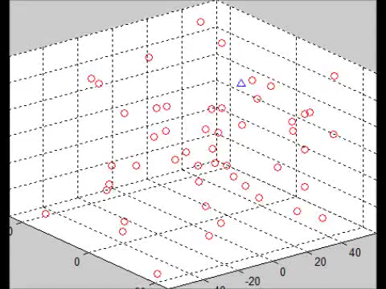
Particle Swarm Optimisation: Example moving target
Optimum moves randomly through design space
Particles do not know position of optimum but do know which particle is closest and are attracted to that one
Precondition: low w value, personal best (b) is zero

Slide 69
Estimation of Distribution Algorithms
MOVIE TOO BIG – PLEASE SEE ELSEWHERE

Slide 70
Learning Classifier Systems: Quick overview Michigan-style
Developed: First described in 1976
Early names: Holland
Typically applied to:
Machine learning tasks working with rule sets
Giving best response to current state environment
Attributed features:
Combination classifier system and learning algorithm
Cooperation (iso usual competition)
Using genetic algorithms
Michigan-style (rule is individual) vs Pittsburgh-style (rule set is individual)

Slide 71
Learning Classifier Systems: Introduction example the multiplexer
k-bit multiplexer is bit-string with length k where
k= l + 2^{l}
l is the address part
2^{l} is the data part
example: l=2, k=6, 101011 correct string
Return the value of the data bit specified by the address part (take position 10 of data part 1011, which is 0)
Rewards can be assigned to the correct answer

Slide 72
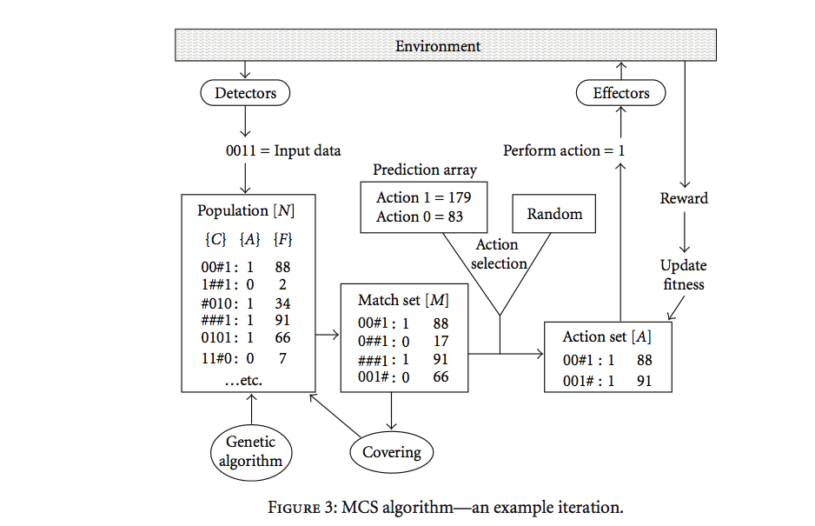
Learning Classifier Systems: Iteration

Slide 73
Learning Classifier Systems: Technical summary tableau Michigan-style
Representation | Tuple of {condition:action:payoff,accuracy} conditions use {0,1,#} alphabet
Recombination | One-point crossover on conditions/actions
Mutation | Binary resetting as appropriate on action/conditions
Parent selection | Fitness proportional with sharing within environmental niches
Survivor selection | Stochastic, inversely related to number of rules covering same environmental niche
Fitness | Each reward received updates predicted pay-off and accuracy of rules in relevant action sets by reinforcement learning

Slide 74
Learning Classifier Systems: Representation
Each rule of the rule base is a tuple {condition:action:payoff}
Match set: subset of rules whose condition matches the current inputs from the environment
Action set: subset of the match set advocating the chosen action
Later, the rule-tuple included an accuracy value, reflecting the system’s experience of how well the predicted payoff matches the reward received

